Slide 1

Welcome
Introduction to ICHRA

Slide 2


XXXXX OE Window:
DATERANGE
Proprietary and confidential

Slide 3
01
Understanding ICHRA and zizzl health
02
Understanding ICHRA Costs
Agenda
03
Understanding ICHRA Plans
04
Action Required
Notes:
Mike

Slide 4
ICHRA 101
Understanding ICHRA

Slide 5


What is an ICHRA?
Individual Coverage Health Reimbursement Arrangement
This type of HRA is an alternative to a traditional group health plan that allows you more choice!
Think of it like a 401(k) plan for health insurance
Employers fund the ICHRA with a defined contribution for each employee that buys a qualified individual health plan
Employees either waive the ICHRA or use it to buy an individual (IFP) health plan from an insurance company of their choice

Slide 6
Freedom of Choice
In Traditional Group:
75% of employers offer just 1 health plan*
With an ICHRA + IFP Plans:
21 Average plans enrolled per employer
7 Average available carriers per employer
Source: Kaiser Family Foundation
Proprietary and confidential
Notes:
Mike

Slide 7

The zizzl health system is an innovative Individual Coverage Health Reimbursement Arrangement (ICHRA) solution.
Our platform aggregates the plan and carrier information you need to select a plan that covers what is most important to you!
The site also features tools to help you ensure
your coverage meets your unique needs.
ABOUT US

Slide 8
ICHRA 101
Understanding ICHRA Costs

Slide 9
How are Plan Premiums Calculated in the Individual Market?
Plan Premiums are community rated
Individual Premiums are determined by:
Age
County
Tobacco Usage
# of Individuals Covered
Guaranteed Coverage
Pre-existing Conditions will NOT affect eligibility or rates

Slide 10

Family Premiums
Family Premium equals the sum of premiums for EACH member covered
The following dependents will add to your total premium:
Your spouse
All children over the age of 21
The 3 oldest children under the age of 21
DEPENDENTSX

Slide 11
Your ICHRA Contribution
Age | 2024 Contribution | Age | 2024 Contribution | Age | 2024 Contribution
0-14 | 0-CONT | 31 | 31CONT | 48 | 48CONT
15 | 15CONT | 32 | 32CONT | 49 | 49CONT
16 | 16CONT | 33 | 33CONT | 50 | 50CONT
17 | 17CONT | 34 | 34CONT | 51 | 51CONT
18 | 18CONT | 35 | 35CONT | 52 | 52CONT
19 | 19CONT | 36 | 36CONT | 53 | 53CONT
20 | 20CONT | 37 | 37CONT | 54 | 54CONT
21 | 21CONT | 38 | 38CONT | 55 | 55CONT
22 | 22CONT | 39 | 39CONT | 56 | 56CONT
23 | 23CONT | 40 | 40CONT | 57 | 57CONT
24 | 24CONT | 41 | 41CONT | 58 | 58CONT
25 | 25CONT | 42 | 42CONT | 59 | 59CONT
26 | 26CONT | 43 | 43CONT | 60 | 60CONT
27 | 27CONT | 44 | 44CONT | 61 | 61CONT
28 | 28CONT | 45 | 45CONT | 62 | 62CONT
29 | 29CONT | 46 | 46CONT | 63 | 63CONT
30 | 30CONT | 47 | 47CONT | 64+ | 64CONT
Your Employer determines the ICHRA Contribution each year.
You must purchase an IFP Health plan to receive the ICHRA Contribution.

Slide 12
Your Dependent ICHRA Contribution
Age | Spouse Contribution | Child Contribution | Age | Spouse Contribution | Child Contribution | Age | Spouse Contribution | Child Contribution
0-14 | 0-SPCONT | 0-CHDCONT | 31 | 31SPCONT | 31CHDCONT | 48 | 48SPCONT | 48CHDCONT
15 | 15SPCONT | 15CHDCONT | 32 | 32SPCONT | 32CHDCONT | 49 | 49SPCONT | 49CHDCONT
16 | 16SPCONT | 16CHDCONT | 33 | 33SPCONT | 33CHDCONT | 50 | 50SPCONT | 50CHDCONT
17 | 17SPCONT | 17CHDCONT | 34 | 34SPCONT | 34CHDCONT | 51 | 51SPCONT | 51CHDCONT
18 | 18SPCONT | 18CHDCONT | 35 | 35SPCONT | 35CHDCONT | 52 | 52SPCONT | 52CHDCONT
19 | 19SPCONT | 19CHDCONT | 36 | 36SPCONT | 36CHDCONT | 53 | 53SPCONT | 53CHDCONT
20 | 20SPCONT | 20CHDCONT | 37 | 37SPCONT | 37CHDCONT | 54 | 54SPCONT | 54CHDCONT
21 | 21SPCONT | 21CHDCONT | 38 | 38SPCONT | 38CHDCONT | 55 | 55SPCONT | 55CHDCONT
22 | 22SPCONT | 22CHDCONT | 39 | 39SPCONT | 39CHDCONT | 56 | 56SPCONT | 56CHDCONT
23 | 23SPCONT | 23CHDCONT | 40 | 40SPCONT | 40CHDCONT | 57 | 57SPCONT | 57CHDCONT
24 | 24SPCONT | 24CHDCONT | 41 | 41SPCONT | 41CHDCONT | 58 | 58SPCONT | 58CHDCONT
25 | 25SPCONT | 25CHDCONT | 42 | 42SPCONT | 42CHDCONT | 59 | 59SPCONT | 59CHDCONT
26 | 26SPCONT | 26CHDCONT | 43 | 43SPCONT | 43CHDCONT | 60 | 60SPCONT | 60CHDCONT
27 | 27SPCONT | 27CHDCONT | 44 | 44SPCONT | 44CHDCONT | 61 | 61SPCONT | 61CHDCONT
28 | 28SPCONT | 28CHDCONT | 45 | 45SPCONT | 45CHDCONT | 62 | 62SPCONT | 62CHDCONT
29 | 29SPCONT | 29CHDCONT | 46 | 46SPCONT | 46CHDCONT | 63 | 63SPCONT | 63CHDCONT
30 | 30SPCONT | 30CHDCONT | 47 | 47SPCONT | 47CHDCONT | 64+ | 64SPCONT | 64CHDCONT

Slide 13
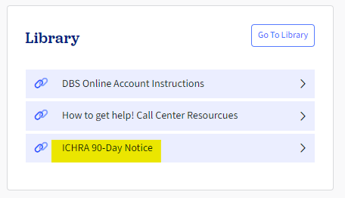

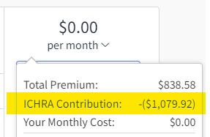
Your ICHRA Contribution
01
Your can review your ICHRA contribution in the zizzl health platform in the following places:
The 90-Day ICHRA Notice, which can be found in the Library section of the site (image 1)
When reviewing plans within your enrollment (image 2)
02

Slide 14
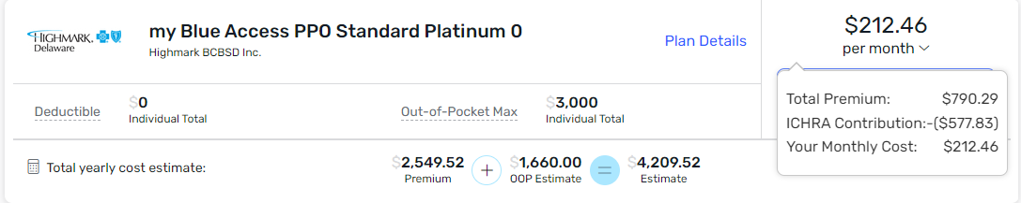
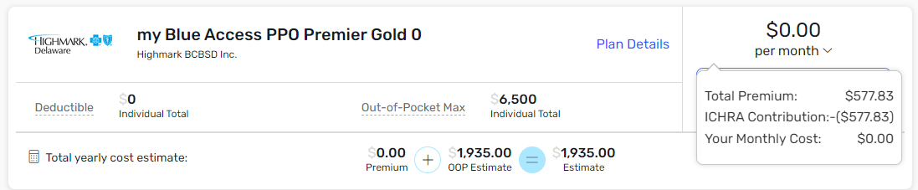
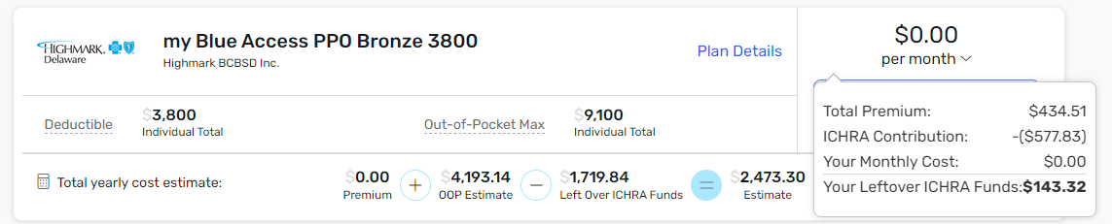
How ICHRA Contributions Work
This example shows how plan costs will vary for an employee with an ICHRA Contribution of $577.83.
Each employee can pick an individual insurance plan that fits their families needs. You can buy a comprehensive plan with your budgeted dollars.
The Employee chooses a more expensive plan and pays $212 per month via pre-tax payroll deductions.
The Employee chooses a plan that costs the same amount as the ICHRA Contribution and pays $0.
The Employee chooses a less expensive Bronze plan and has a $0 monthly cost, with unspent funds.

Slide 15

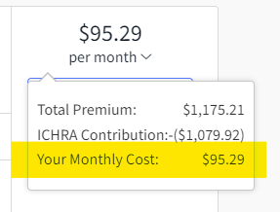
What if your chosen plan costs MORE than the Employer Contribution?
You pay the difference in your paycheck.
Notes:
Mike

Slide 16
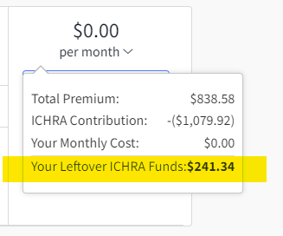



What if your chosen plan costs LESS than the Employer Contribution?
Employees can spend the difference (left-over funds) on co-pays, co-insurance, deductibles, and other qualified medical, dental and vision care expenses.
Notes:
Mike

Slide 17
ICHRA 101
Understanding ICHRA Plans

Slide 18

All Individual/Family Plans Provide Preventative Care
Services FREE on the first day of coverage:
Cholesterol Screenings
Blood Pressure Screenings
Cancer Screenings
Screenings for Children
STI Screenings
Immunization Vaccines

Slide 19
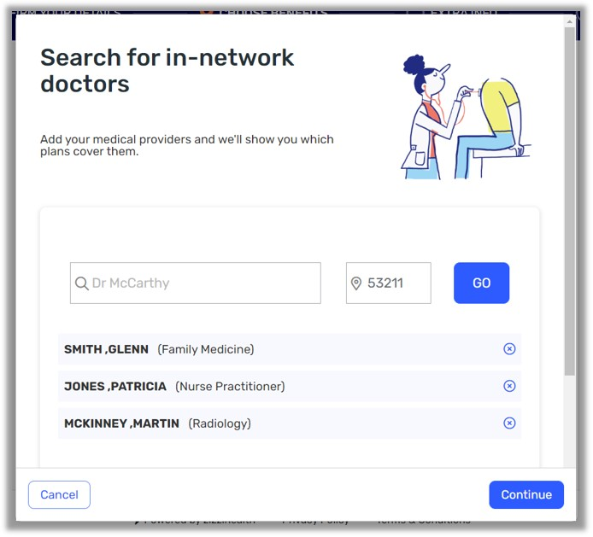
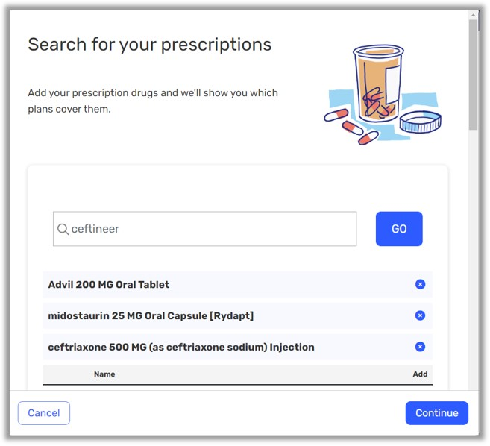
Provider and Prescription Search Tools
Please note: Not all provider directories are current or comprehensive. It is the user’s sole responsibility to confirm whether or not their provider is participating. Contact the carrier directly to confirm your physician's participation.
Proprietary and confidential

Slide 20
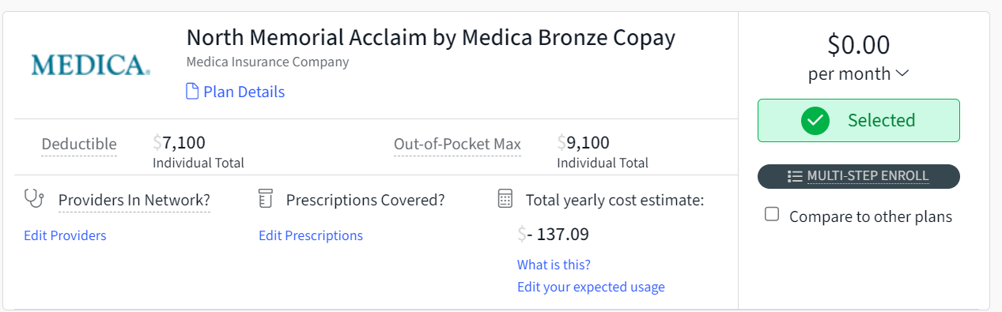
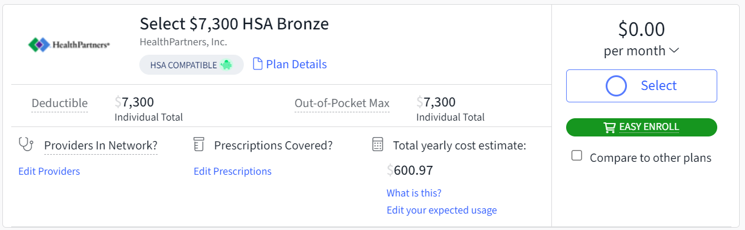
Multi Step v. Easy Enroll
You will be able to see within the enrollment if a plan is “Easy” or “Multi-step” enroll. Multi-step indicates there may be additional steps that require you to log into your carrier’s member portal and take action. Once you select a Multi-Step plan, those steps will be communicated to you.
Proprietary and confidential

Slide 21

Compatibility with Spending and Savings Accounts
Supplemental products can be used in conjunction with an ICHRA.
Healthcare Flexible Spending Accounts
Health Savings Accounts*
Medicare Supplemental Plans
*Health Savings Accounts require the employee to meet minimum HSA contributions ($1,600 single/ $3,200 family in 2024) before the ICHRA Leftover Dollars can be spent.

Slide 22
Action Required

Slide 23

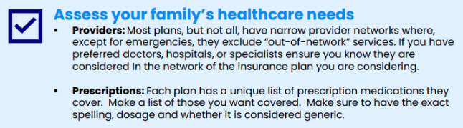
What do you Need to Do Before Open Enrollment?
Get ready to select your benefits during Open Enrollment! Follow these steps to successfully prepare for your enrollment:
Proprietary and confidential

Slide 24

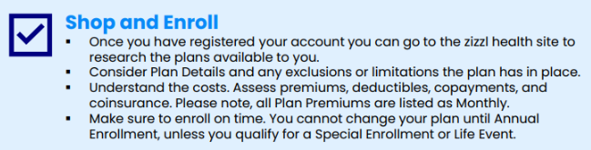

What do you Need to Do During Open Enrollment?
Proprietary and confidential

Slide 25
What do you Need to Do After Open Enrollment?
With an individual health plan, you may have ongoing responsibilities to ensure your coverage is active and correct.
Responsibilities may Include:
Be alert for communication coming from:
zizzl health (support@zizzlhealth.com)
Your Health Insurance carrier
Complete any post-enrollment action required for any Multi-Step enrollments
Report Qualifying Events within 30 days
Report Address Changes
Proprietary and confidential

Slide 26
What if you are Medicare Eligible?
Prior to turning 65 you must work with a Medicare consultant to enroll. You will find our preferred Medicare Partner to work with in your enrollment.
Most Individual and Family (IFP) plans available through the zizzl health portal will not cover individuals who are Medicare Eligible or Enrolled. (Each carrier has their own rules around covering or not covering individuals who are Medicare eligible).
An alternative is to work with a Medicare specialist who can assist you to enroll in a Medicare Supplemental plan.
Additional information will be available within your zizzl health enrollment.
MEDICAREX
Proprietary and confidential

Slide 27
Thank You!

